Slide 1
RESEARCH PAPER IMPLEMENTATION
Fashion Image Generation
Using DCGAN
Deep Convolutional Generative Adversarial Network
GUNJAN P BALAPURE | PRN: 202401110027
Subject: Generative AI
PyTorch • Fashion-MNIST • Google Colab

Slide 2
1. Problem Statement & Objectives
• Goal: generate new grayscale fashion images from random noise.
• Use an unconditional GAN: no class label is supplied to the Generator.
• Implement the core DCGAN methodology using Python and PyTorch.
• Train on Fashion-MNIST and inspect generated samples and training losses.
• Identify limitations and propose improvements.
DCGAN • Fashion-MNIST • Generative AI
2

Slide 3
2. Selected Research Paper
Unsupervised Representation Learning with Deep Convolutional Generative Adversarial Networks
Alec Radford, Luke Metz and Soumith Chintala • arXiv:1511.06434 • 2015 (ICLR 2016)
• Proposes architectural guidelines for stable convolutional GAN training.
• Uses convolutional and transposed-convolutional layers to learn image features.
• Uses ReLU in the Generator, LeakyReLU in the Discriminator and Tanh at Generator output.
• This project adapts the core approach to 28 × 28 grayscale Fashion-MNIST images.
DCGAN • Fashion-MNIST • Generative AI
3

Slide 4
3. What is a GAN?
GENERATOR (G)
DISCRIMINATOR (D)
Input: 100-dimensional random noise
Output: synthetic 28 × 28 fashion image
Goal: make generated images look real.
Input: real or generated image
Output: probability that image is real
Goal: distinguish real from fake.
The two networks are trained alternately and improve through competition.
DCGAN • Fashion-MNIST • Generative AI
4

Slide 5
4. Dataset: Fashion-MNIST
• 60,000 training images used; the standard dataset also includes 10,000 test images.
• 10 categories: T-shirt/top, trouser, pullover, dress, coat, sandal, shirt, sneaker, bag and ankle boot.
• Each image is 28 × 28 pixels with one grayscale channel.
• Preprocessing: ToTensor() and Normalize((0.5,), (0.5,)), mapping pixels to approximately [−1, 1].
• Labels are not used for training because this is an unconditional DCGAN.
DCGAN • Fashion-MNIST • Generative AI
5

Slide 6
5. Model Architecture
GENERATOR
DISCRIMINATOR
100 × 1 × 1 noise
↓
ConvTranspose: 256 × 7 × 7
↓
ConvTranspose: 128 × 14 × 14
↓
ConvTranspose + Tanh
1 × 28 × 28 image
1 × 28 × 28 image
↓
Conv2D: 64 × 14 × 14
↓
Conv2D: 128 × 7 × 7
↓
Conv2D + Sigmoid
Real / Fake probability
Batch normalization is used in intermediate layers. Generator uses ReLU; Discriminator uses LeakyReLU.
DCGAN • Fashion-MNIST • Generative AI
6

Slide 7
6. Experimental Setup & Training
• Platform: Google Colab; accelerator: NVIDIA Tesla T4 GPU.
• Framework: Python, PyTorch and Torchvision.
• Latent dimension: 100; batch size: 128; learning rate: 0.0002.
• Loss: Binary Cross Entropy; optimizer: Adam with betas (0.5, 0.999).
• Each batch updates the Discriminator, then updates the Generator to fool it.
• Fixed noise vectors are used to monitor generated samples across epochs.
DCGAN • Fashion-MNIST • Generative AI
7

Slide 8
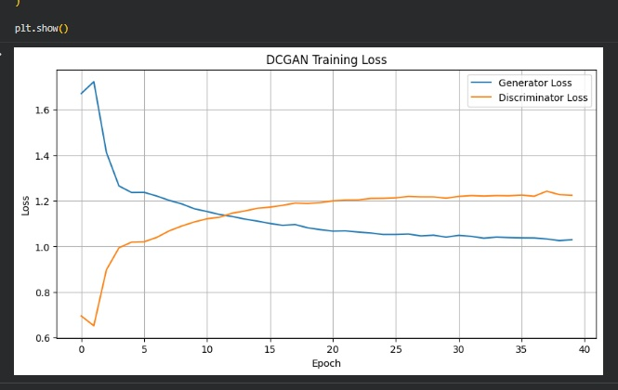
7. Training Results: Loss Curves
Observed trend
Generator loss: approximately 1.68 → 1.03
Discriminator loss: approximately 0.70 → 1.22
Values are approximate visual readings from the submitted graph. GAN losses can fluctuate and are not a standalone image-quality metric.
DCGAN • Fashion-MNIST • Generative AI
8

Slide 9
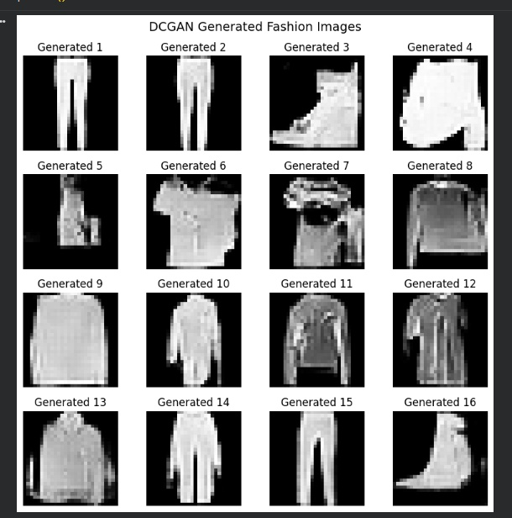
8. Generated Fashion Images
Observations
• Several outputs show recognizable clothing-like structures.
• Different latent vectors produce different samples.
• Some outputs remain blurry, coarse or imperfect.
• The model learns broad patterns, not guaranteed classes.
DCGAN • Fashion-MNIST • Generative AI
9

Slide 10
9. Experimental Record & Limitations
TRAINING RECORD
LIMITATIONS
Configured epochs: 20
Recorded loss entries: 40
The 20-epoch cell was executed twice in the same runtime. The second execution continued from existing model weights and loss-history lists. Therefore, the notebook records 40 consecutive epochs across two executions.
• Low resolution limits image detail.
• GAN training can be unstable.
• Outputs can be blurry; mode collapse is possible.
• No quantitative FID evaluation was performed.
• Unconditional generation cannot select a target class.
DCGAN • Fashion-MNIST • Generative AI
10

Slide 11
10. Improvements, Conclusion & References
POSSIBLE IMPROVEMENTS
CONCLUSION
• Conditional GAN for class-controlled output
• WGAN-GP or spectral normalization for stability
• Deeper architecture or higher-resolution data
• Quantitative evaluation with suitable metrics
The project implemented the core DCGAN workflow in PyTorch. The trained Generator produced recognizable fashion-like samples, demonstrating learned visual structure, while image sharpness and training stability remain areas for improvement.
REFERENCES
[1] Radford, Metz & Chintala, arXiv:1511.06434 (2015).
[2] Xiao, Rasul & Vollgraf, Fashion-MNIST, arXiv:1708.07747 (2017).
[3] Goodfellow et al., Generative Adversarial Nets, NeurIPS (2014).
DCGAN • Fashion-MNIST • Generative AI
11

